Slide 1
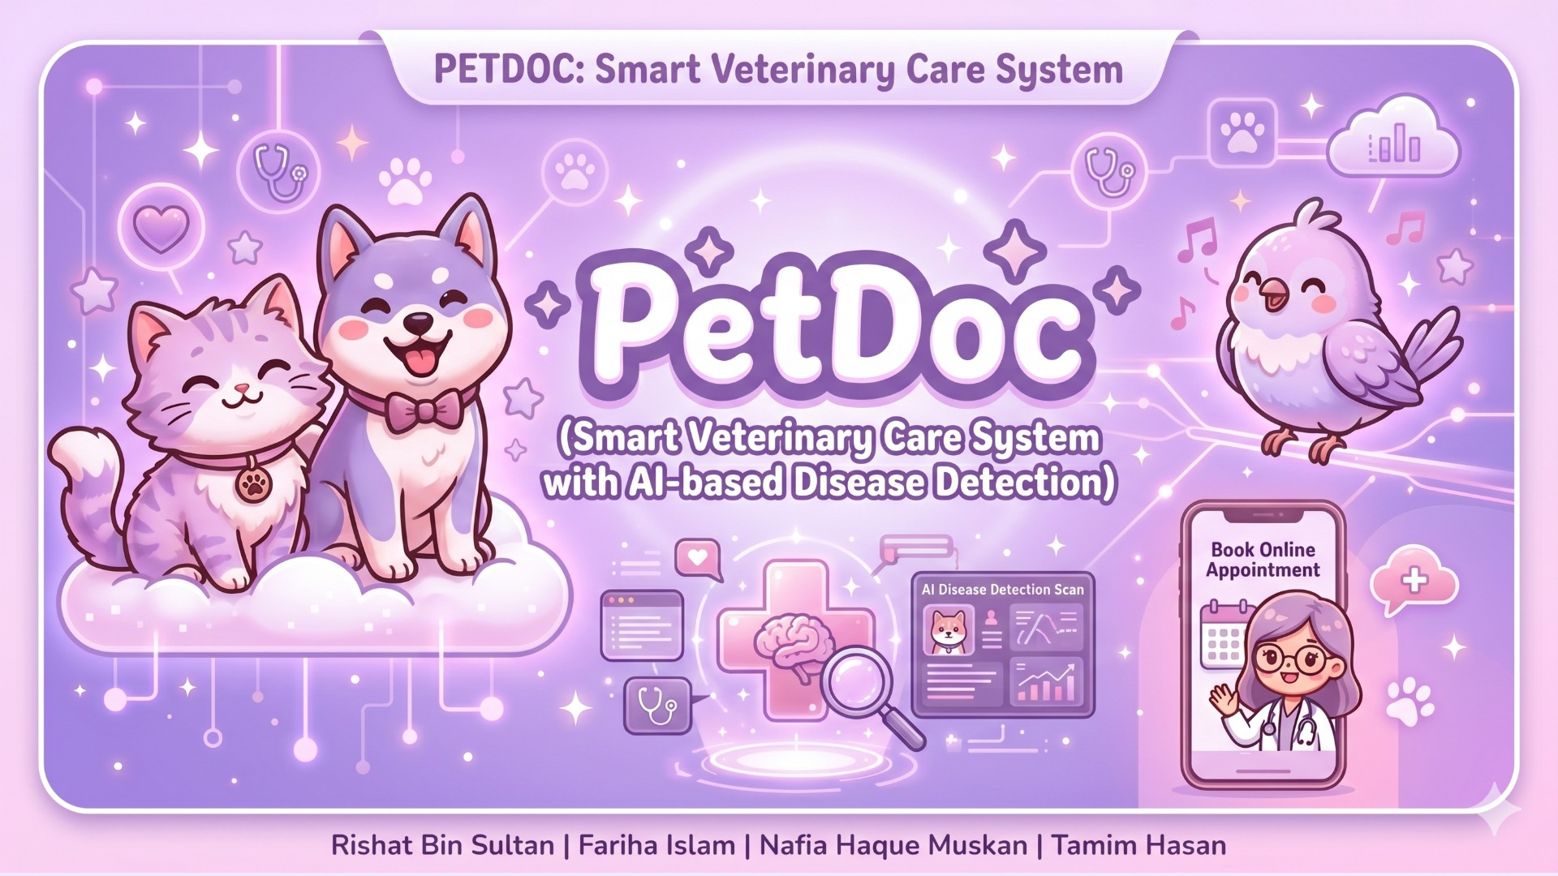

Slide 2
🐾
📋
Table of Contents
🌸
🐾
💜
1
🌸 Project Overview
2
🎉 Introduction
3
⚠️ Problem Statement
4
✨ Our Solution
5
🎯 Objectives
6
🏗️ System Architecture
7
📋 Methodology
8
💻 Implementation
9
📈 Performance
10
🧗 Challenges
11
⚠️ Limitations
12
🚀 Future Work
✨
13
🎉 Conclusion
14
📚 References
🐾 Group 05 | Rishat Bin Sultan, Fariha Islam, Nafia Haque Muskan, MD Tamim Hasan
💜

Slide 3
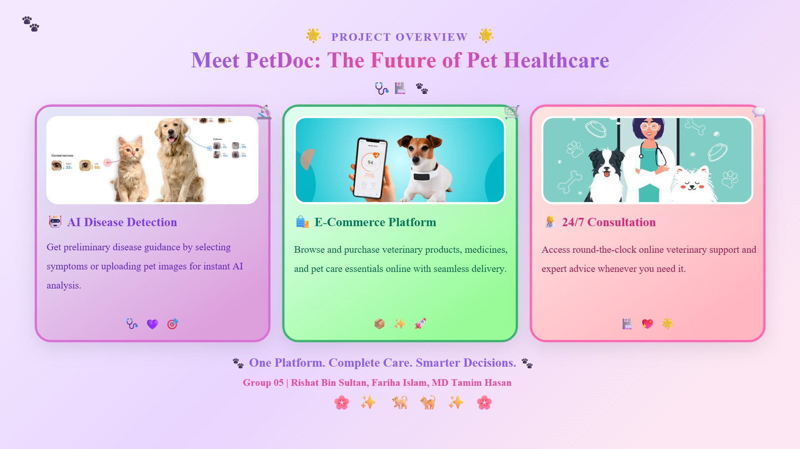

Slide 4
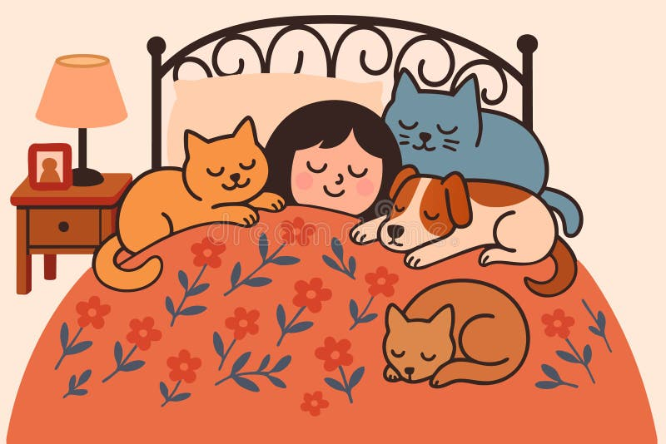
🐾
🎉
I. Introduction
🐾
🐾
⭐
❤️
Pets in Our Lives
Essential companions providing love, emotional support, and joy
⚠️
Healthcare Challenges
Geographic barriers, high costs, limited clinic availability
🔍
Early Detection Gap
Symptoms often missed due to lack of medical knowledge
💡
Technology Solution
AI + online services enable intelligent healthcare platforms
🏠 Pets = Family 💕
🎯
PetDoc Mission
Integrated system combining product purchasing with AI disease detection
🐾 Group 05 | Rishat Bin Sultan, Fariha Islam, Nafia Haque Muskan, MD Tamim Hasan
🌸

Slide 5
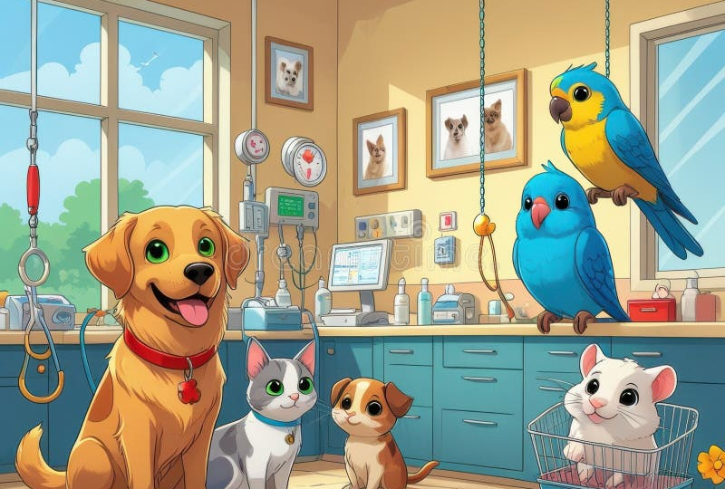
🐾
⚠️
II. Problem Statement
🐾
🐾
🏙️
Urban Concentration
💜
Veterinary facilities mainly in cities, rural areas underserved
💰
High Costs
Expensive consultations limit access for many pet owners
⏰
Limited Availability
Busy schedules and few clinics create access barriers
😰
Late Detection
Owners miss early symptoms due to limited medical knowledge
😿 We Need a Better Solution! 🆘
📱
Platform Limitations
Existing platforms only offer sales/scheduling, no AI diagnostics
🐾 Group 05 | Rishat Bin Sultan, Fariha Islam, Nafia Haque Muskan, MD Tamim Hasan
💔

Slide 6

🐾
✨
III. Our Solution
💡
🐾
🎯
PetDoc Platform
Integrated web-based veterinary system with AI + e-commerce
🔬
AI Disease Detection
CNN analyzes pet images and symptoms for instant predictions
💊
Smart Recommendations
AI suggests relevant medicines and products based on diagnosis
🛒
Integrated E-Commerce
One-stop shop for veterinary products and medicines
🤖 AI to the Rescue! 🏥
👥
Multi-Role System
Separate modules for users, admins, and delivery personnel
🐾 Group 05 | Rishat Bin Sultan, Fariha Islam, Nafia Haque Muskan, MD Tamim Hasan
🐾

Slide 7
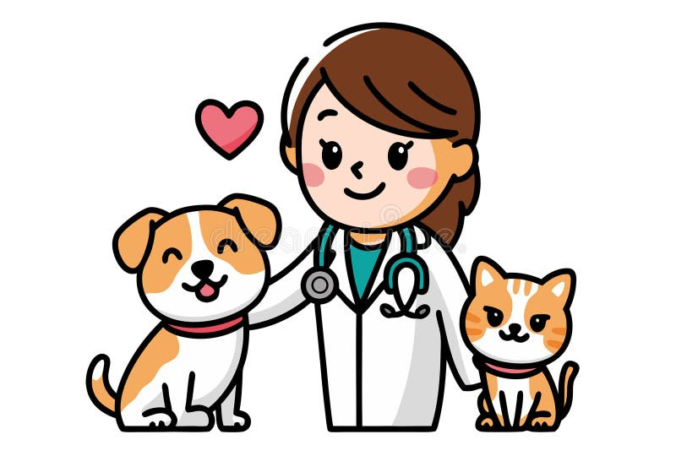
🐾
🎯
IV. Objectives
🐕
🐾
🖥️
User-Friendly Platform
💜
Intuitive online veterinary system for pet owners
🧠
AI Disease Detection
Early identification using machine learning
⚡
Instant Guidance
Real-time health advice through intelligent analysis
🛍️
Online Shop
Full e-commerce for veterinary products
🎉 All Objectives Achieved! 🏆
👥
Role-Based Modules
Separate access for users, admins, delivery
🌍
Remote Accessibility
Veterinary services available from anywhere
🐾 Group 05 | Rishat Bin Sultan, Fariha Islam, Nafia Haque Muskan, MD Tamim Hasan
🌟

Slide 8
🐾
🏗️
V. System Architecture
⚙️
🐾
⭐
🖥️
Presentation Layer
HTML, CSS, Bootstrap frontend for user interaction
🏗️
⚙️
Application Layer
Three-Tier Design (MVT)
Django backend with AI processing and business logic
🖥️ Presentation
💾
Data Layer
⬇️
Relational database for users, pets, products, orders
⚙️ Application
🤖
AI Integration
⬇️
CNN model for real-time disease detection
💾 Data
🔐
Security
Authentication, validation, and controlled access
🏗️ Three-Tier Design 💻
🐾 Group 05 | Rishat Bin Sultan, Fariha Islam, Nafia Haque Muskan, MD Tamim Hasan
🐾

Slide 9
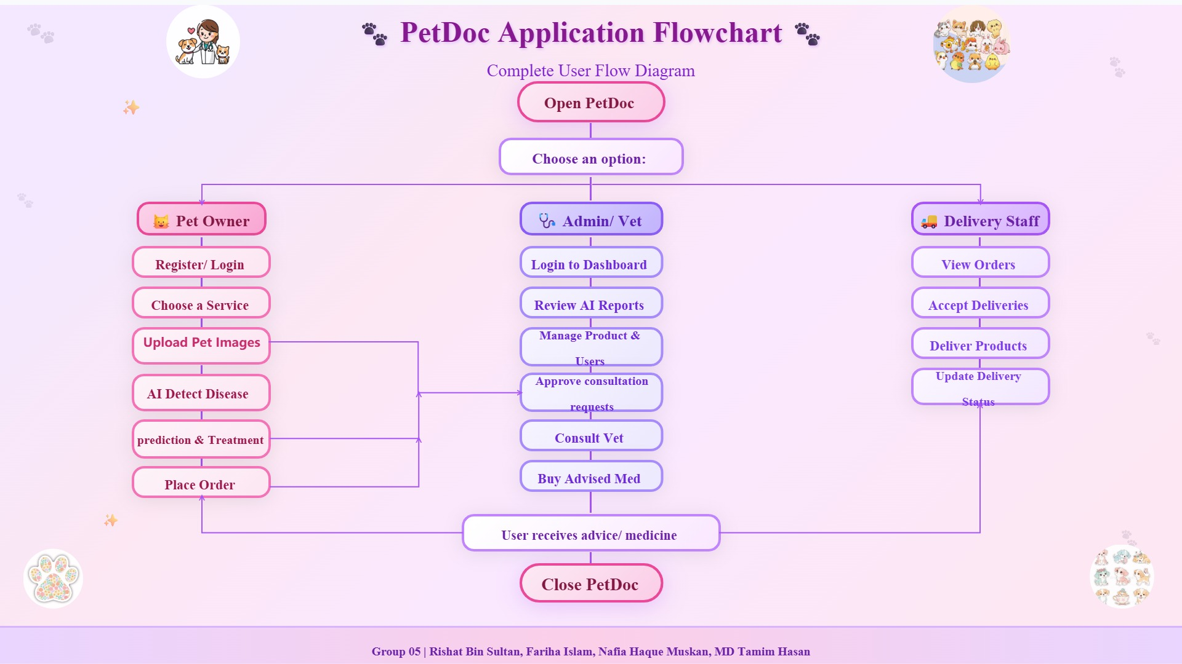

Slide 10
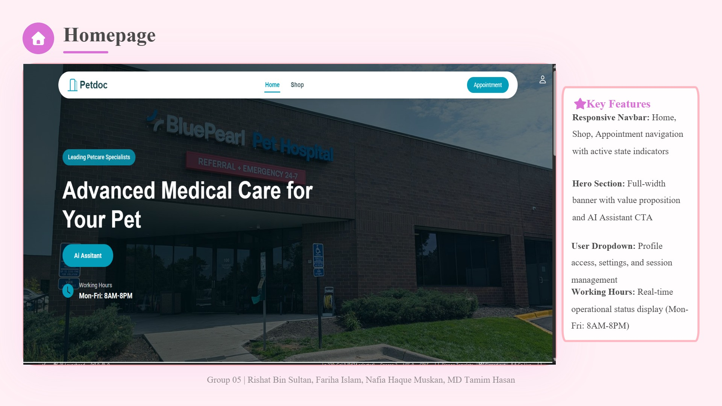

Slide 11
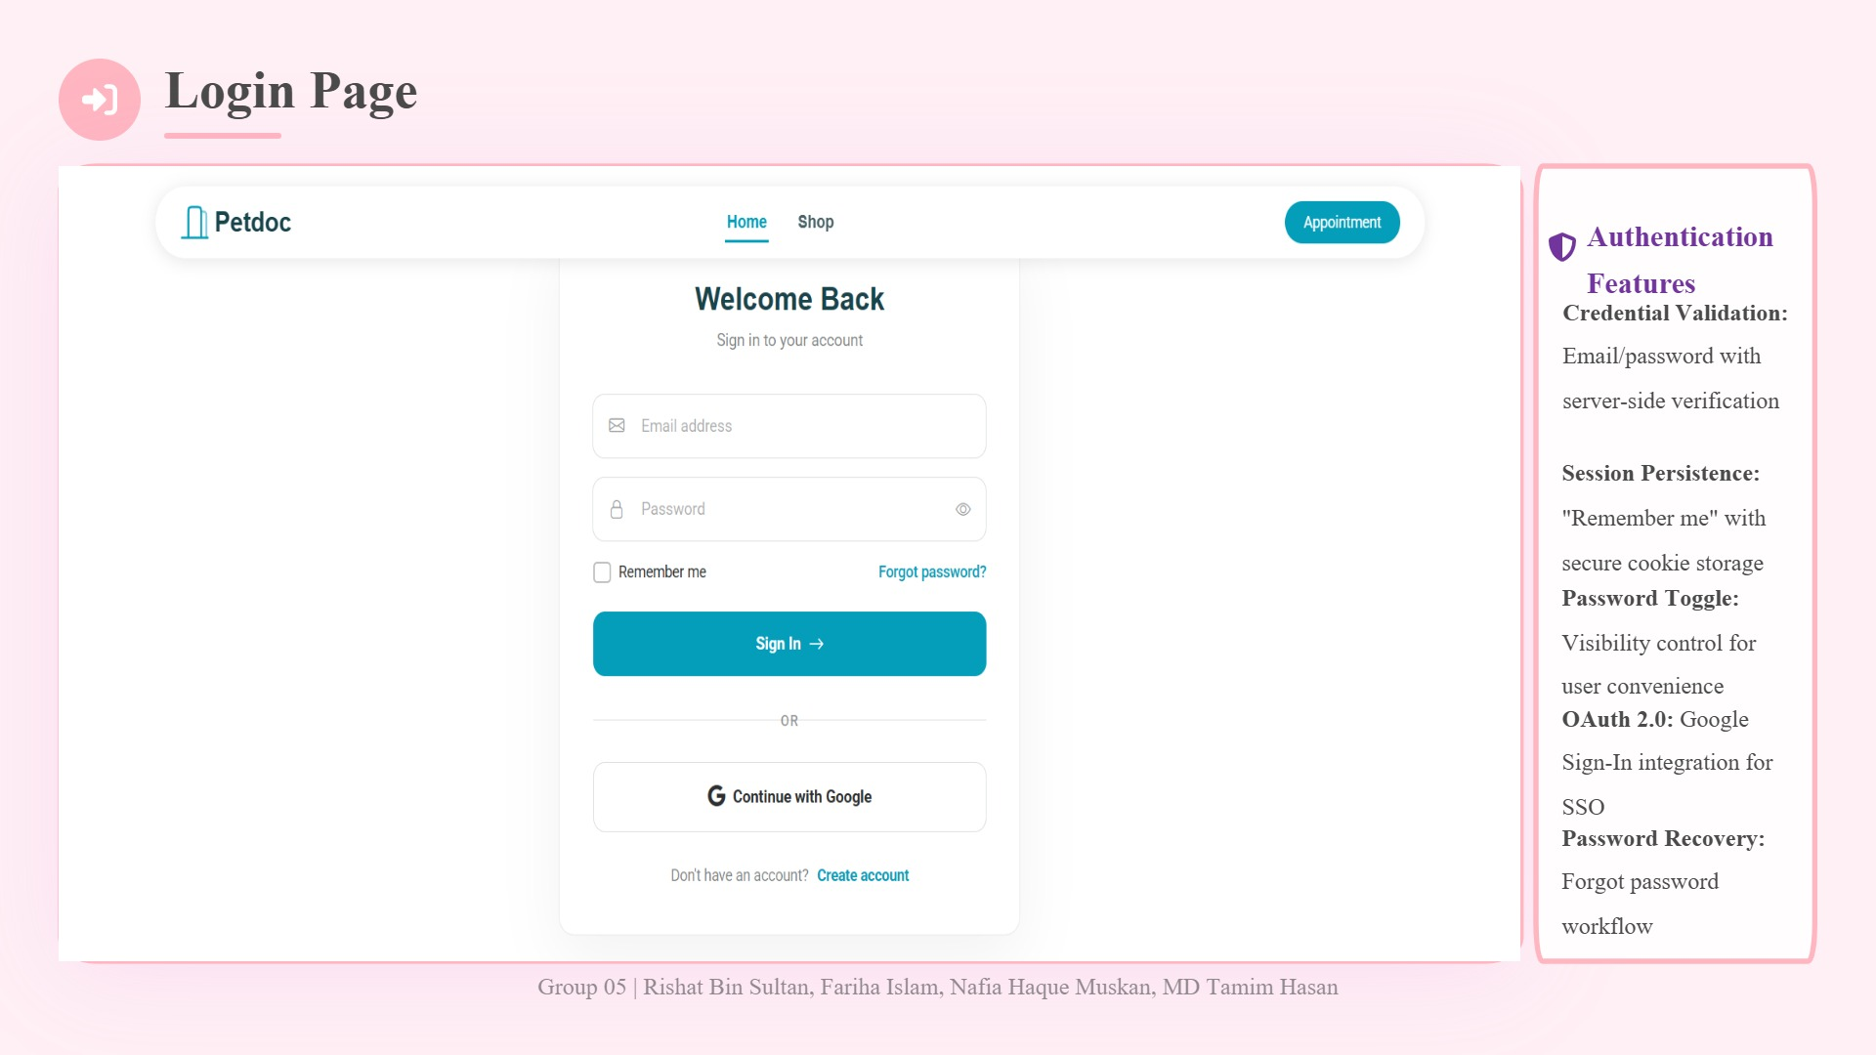

Slide 12
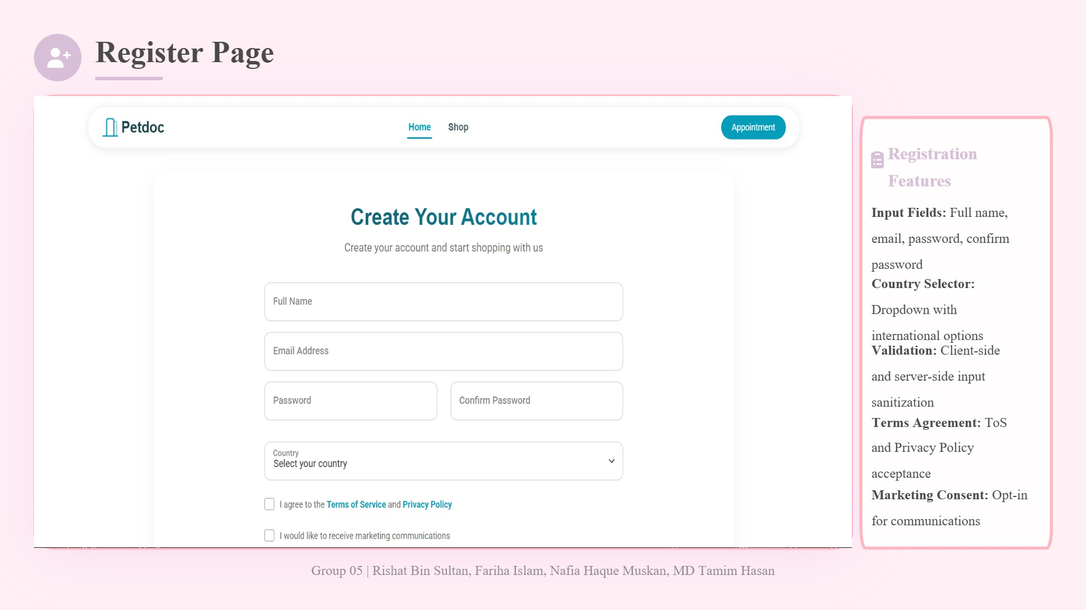

Slide 13
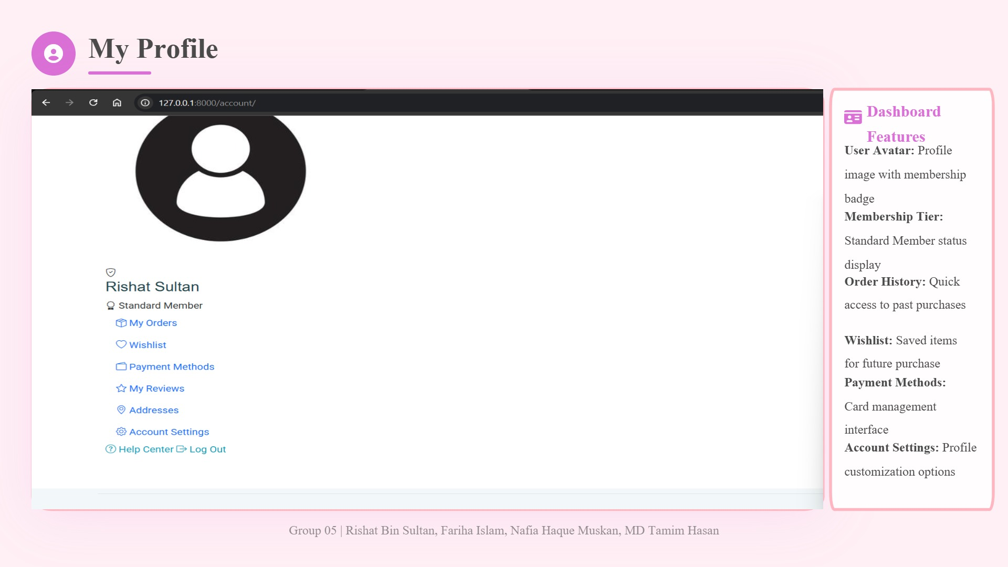

Slide 14
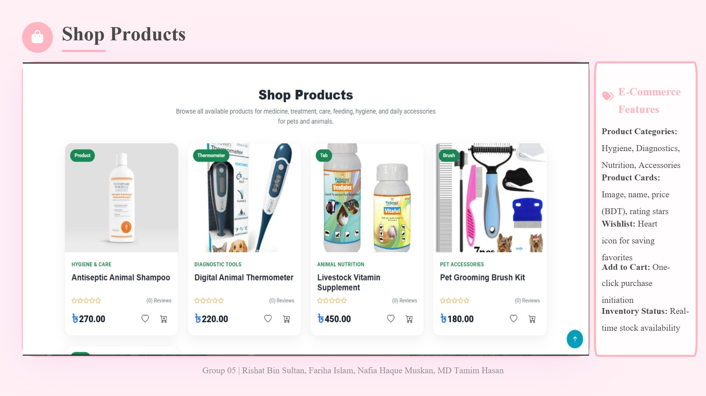

Slide 15
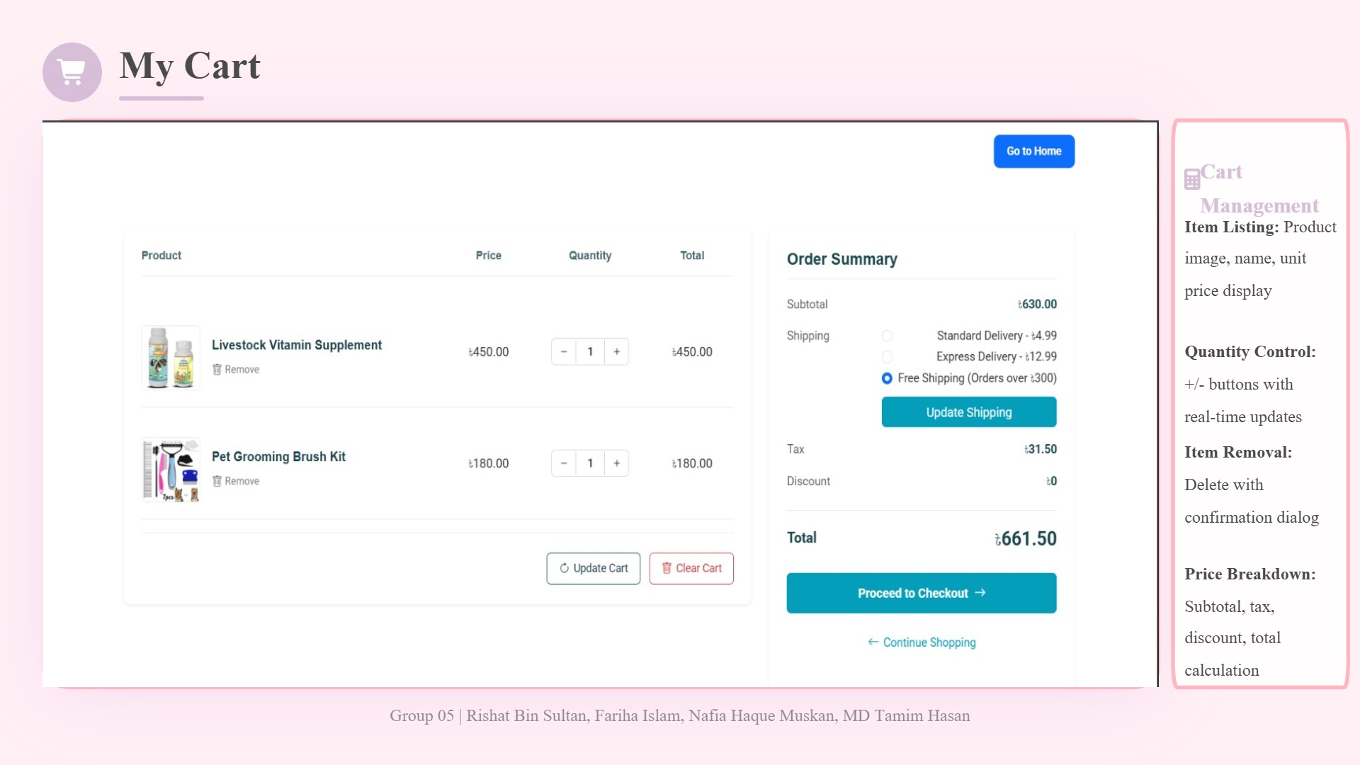

Slide 16
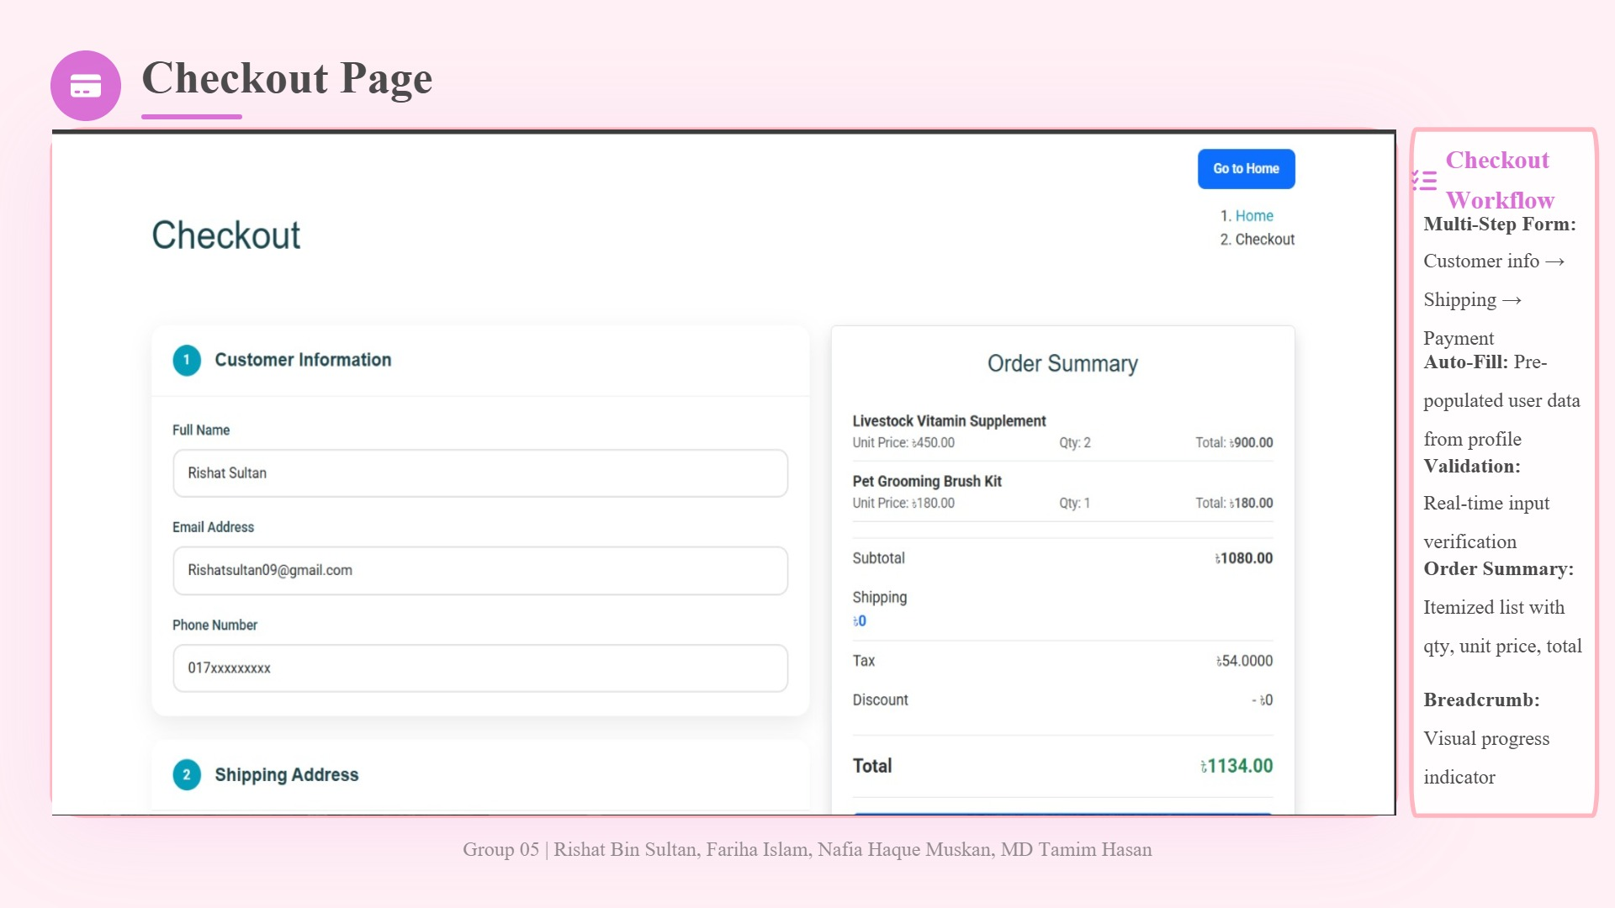

Slide 17
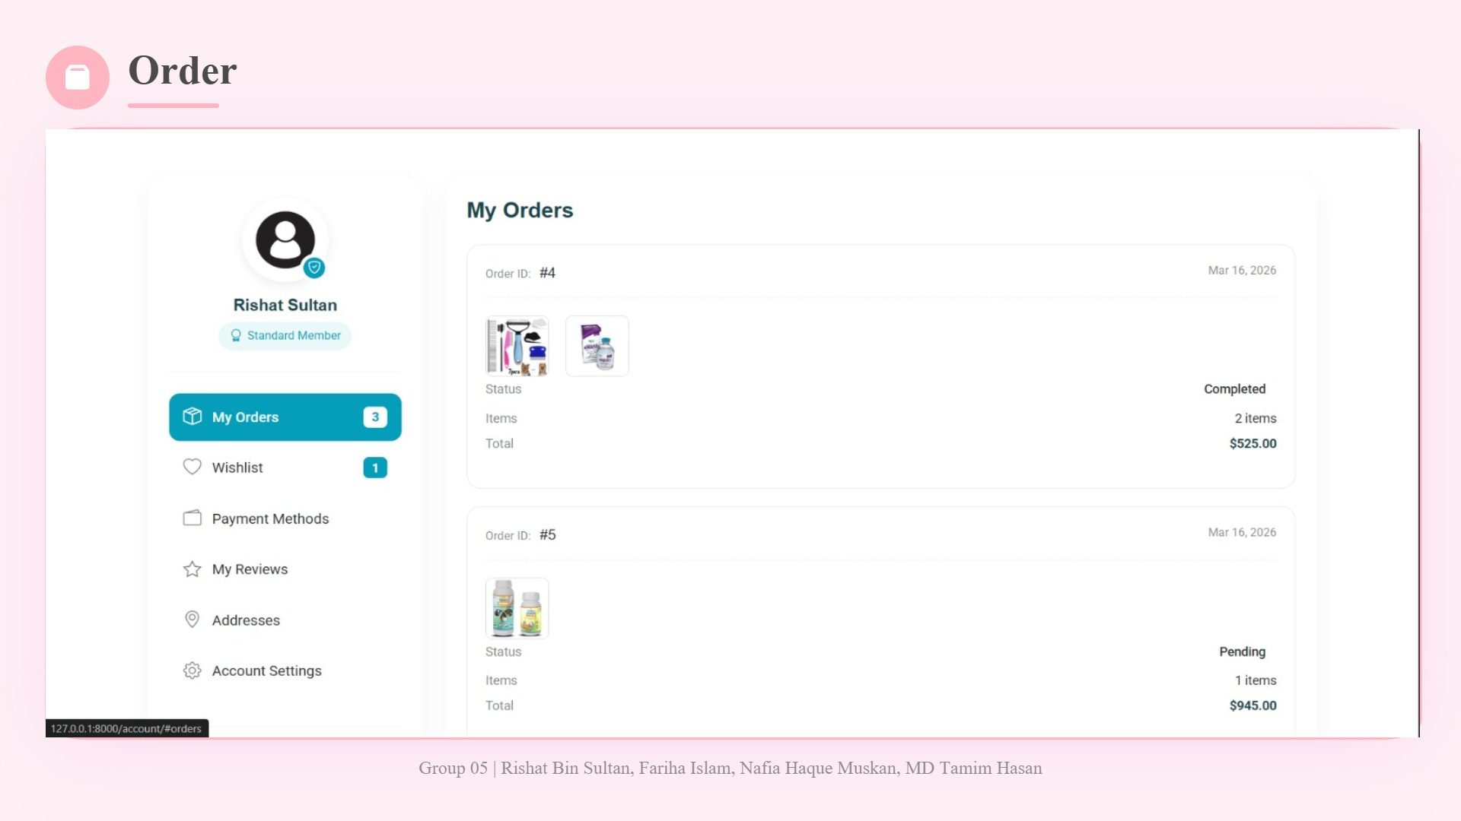

Slide 18
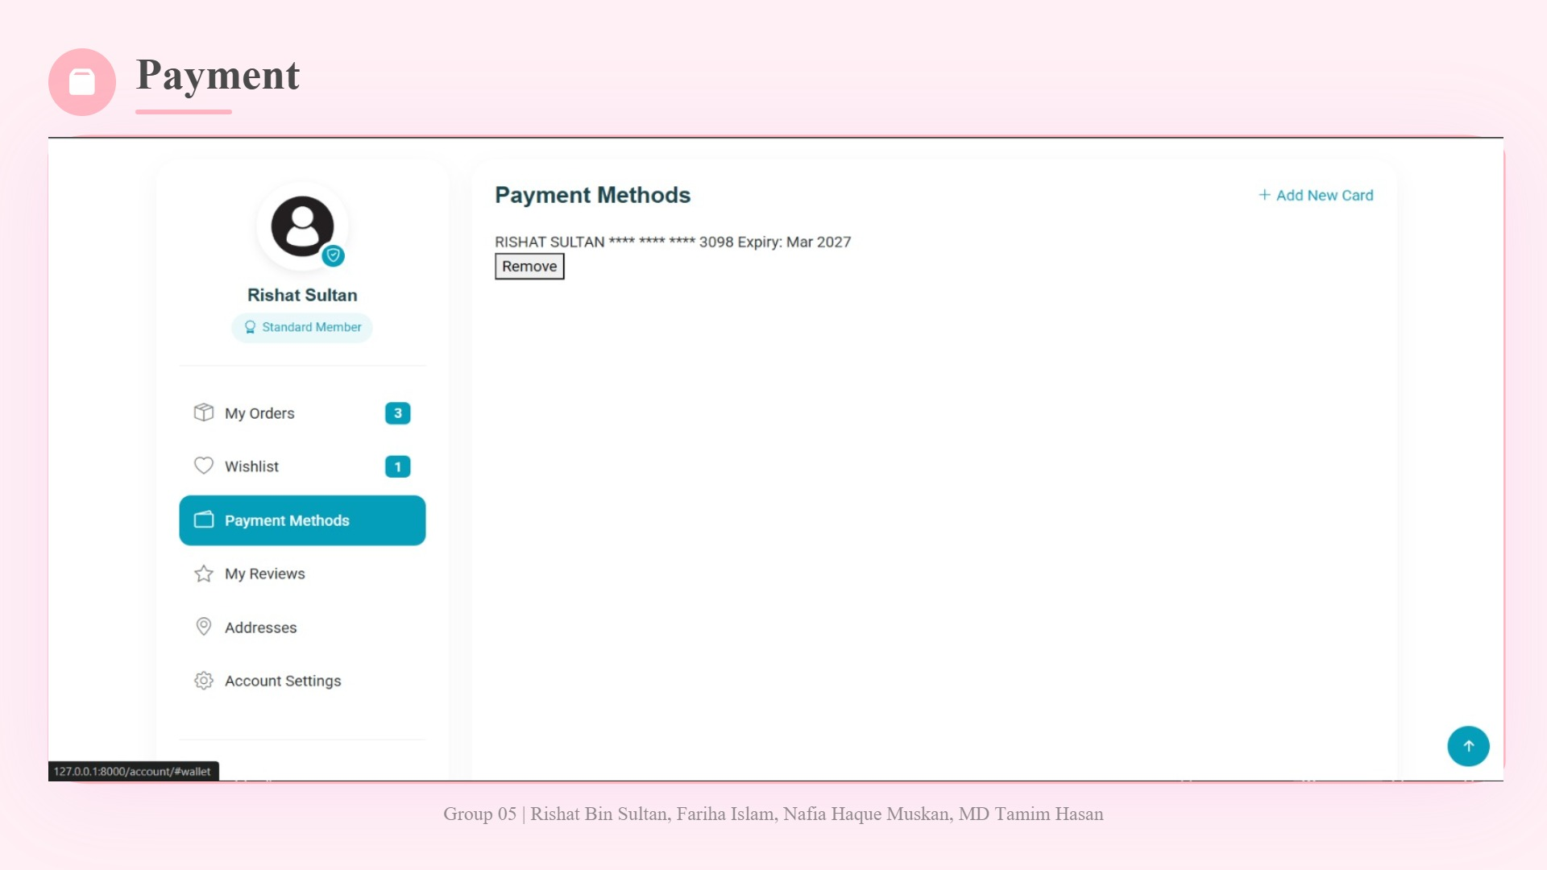

Slide 19
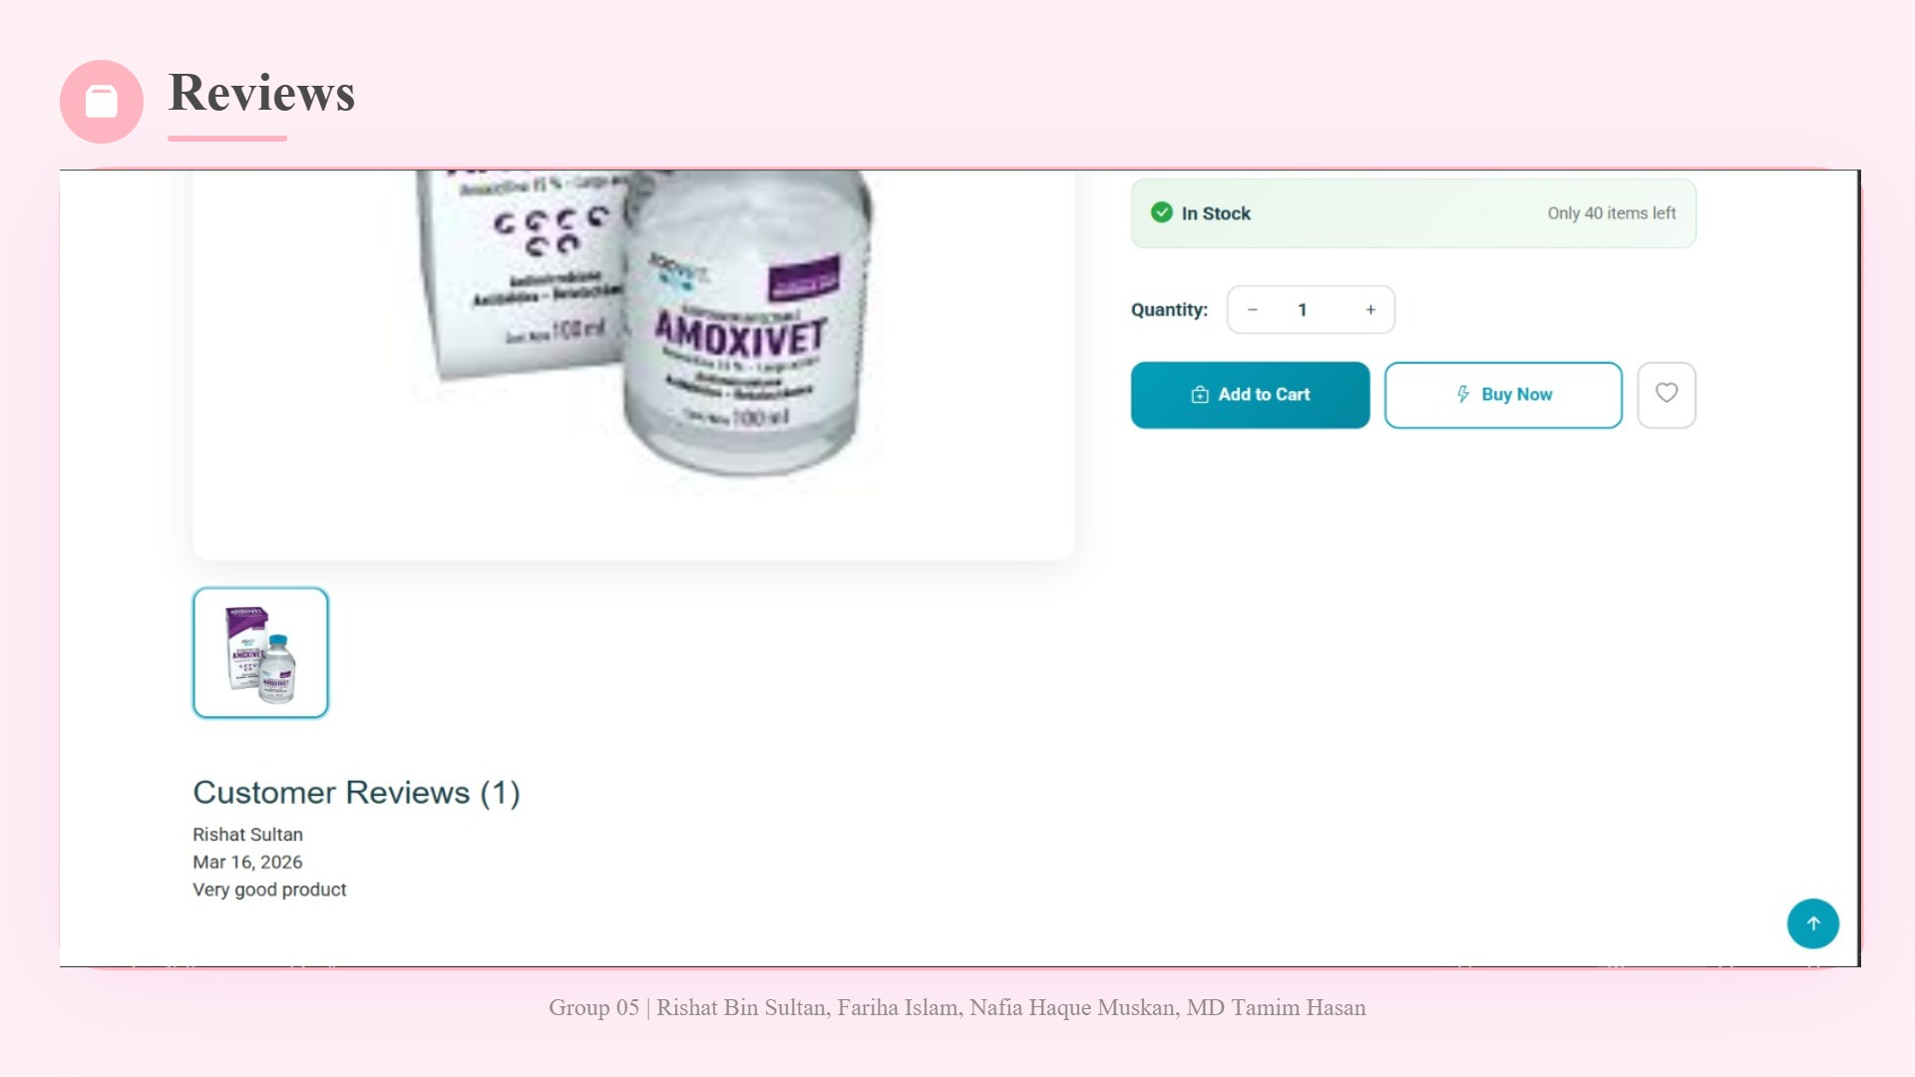

Slide 20
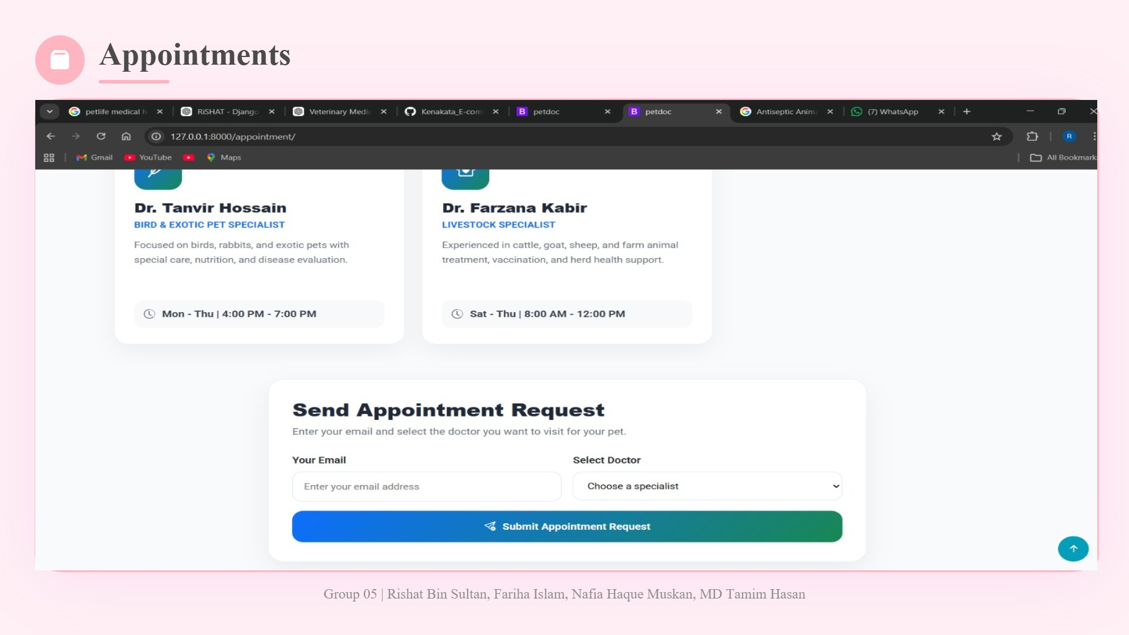

Slide 21
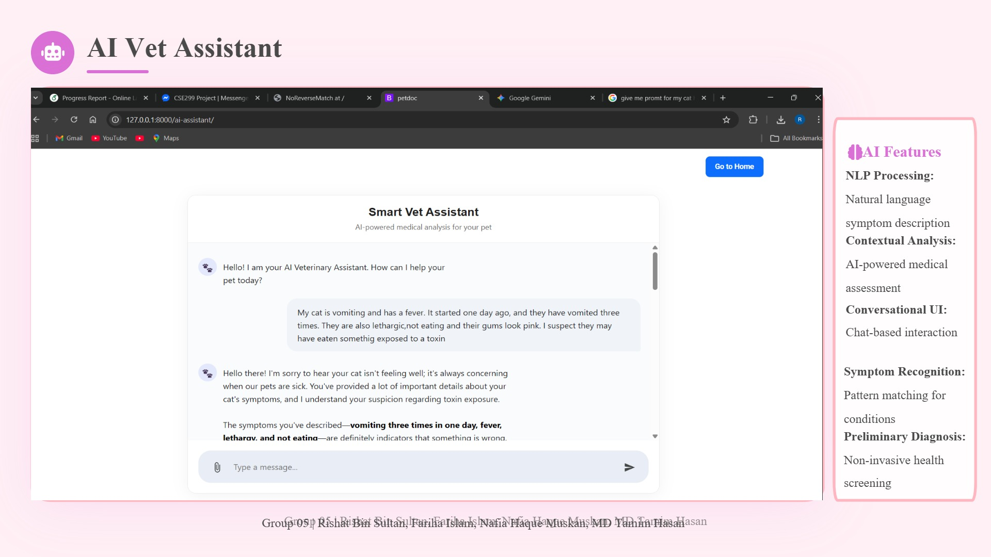

Slide 22
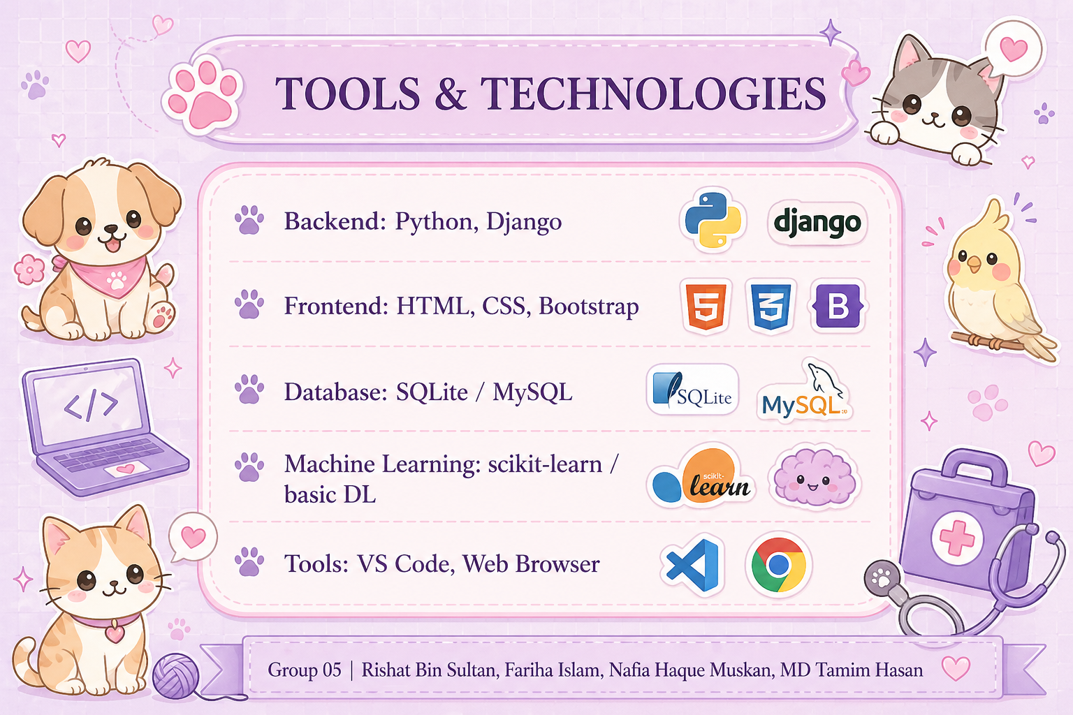

Slide 23

🐾
📋
VII. Methodology
🔬
🐾
💜
1️⃣
Requirement Analysis
Identified key problems and defined system requirements
2️⃣
System Design
Three-tier architecture, database schema, use case diagrams
3️⃣
Data Collection
Veterinary datasets gathered, preprocessed, and labeled
4️⃣
Model Development
CNN trained on Google Colab with hyperparameter tuning
🔬 Systematic Approach 📊
5️⃣
Implementation
Frontend + Backend development
6️⃣
Integration & Testing
All modules combined and optimized
🐾 Group 05 | Rishat Bin Sultan, Fariha Islam, Nafia Haque Muskan, MD Tamim Hasan
🐾

Slide 24

🐾
💻
VIII. Implementation
🐾
🐾
⭐
🎨
Frontend
HTML, CSS, Bootstrap for responsive, user-friendly interface
⚙️
Backend
Django framework with MVT architecture for scalability
🤖
AI Model
CNN trained on veterinary datasets, integrated for real-time predictions
💬
AI Assistant
Dynamic responses, basic guidance, enhanced user engagement
🚀 Fully Functional & Ready! 🎉
👥
Role-Based Modules
Admin panel, delivery system, user management
🐾 Group 05 | Rishat Bin Sultan, Fariha Islam, Nafia Haque Muskan, MD Tamim Hasan
⚙️

Slide 25

🐾
📈
IX. Performance
🏆
🐾
🎯
AI Accuracy
💜
85-90% accuracy for common conditions
⚡
Response Time
Efficient processing across all functionalities
😊
User Satisfaction
High satisfaction with intuitive interface
🛡️
System Stability
Consistent performance under moderate load
🏆 Excellent Results! 🌟
🔄
Integration Success
E-commerce + AI work seamlessly together
🐾 Group 05 | Rishat Bin Sultan, Fariha Islam, Nafia Haque Muskan, MD Tamim Hasan
🐾

Slide 26
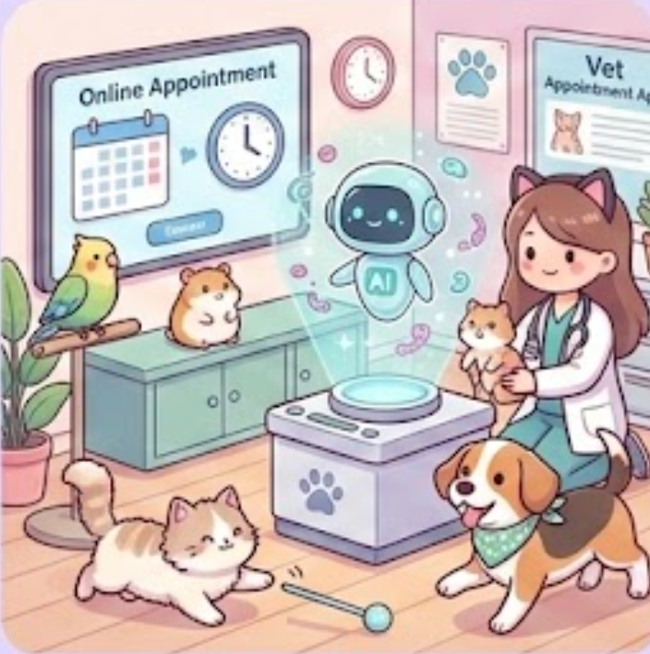
🐾
🧗
X. Challenges
🐾
🐾
⭐
📊
Limited Datasets
Veterinary data scarce and less standardized than human medical data
🔌
ML Integration
Complex integration of AI model with Django backend
⏱️
API Latency
Managing AI assistant response times
🔄
Synchronization
Frontend-backend coordination for real-time updates
💪 Challenges Overcome! 🏆
🔒
Data Security
Protecting sensitive user and pet health information
🐾 Group 05 | Rishat Bin Sultan, Fariha Islam, Nafia Haque Muskan, MD Tamim Hasan
⚡

Slide 27

🐾
⚠️
XI. Limitations
🔍
🐾
💜
📊
Limited Dataset
Small dataset reduces generalization across breeds and conditions
🏥
Not a Replacement
Preliminary guidance only, not substitute for professional vets
📸
Image Quality
Poor images (blur, low light) affect prediction accuracy
📝
Symptom Ambiguity
Incomplete user input affects recommendations
🔍 Room for Improvement 📈
🌐
Internet Dependency
Requires stable connectivity for features
🐾 Group 05 | Rishat Bin Sultan, Fariha Islam, Nafia Haque Muskan, MD Tamim Hasan
🐾

Slide 28
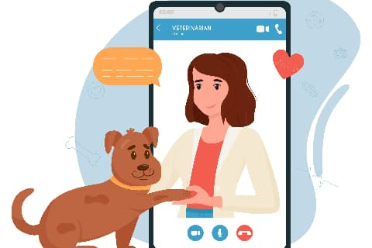
🐾
🚀
XII. Future Work
🐾
🐾
📱
Mobile Apps
Android/iOS applications for better accessibility
🌐
IoT Integration
Connect with wearables for continuous monitoring
🧠
Advanced AI
Transfer learning, ensemble models, Vision Transformers
💬
Tele-Veterinary
Live chat/video consultations with licensed vets
🔮 Exciting Future Ahead! 🌟
🌍
Multi-Language
Support for Bengali and regional languages
🏥
Broader Coverage
Extend to cats, birds, livestock, and more
🐾 Group 05 | Rishat Bin Sultan, Fariha Islam, Nafia Haque Muskan, MD Tamim Hasan
✨

Slide 29

🐾
🎉
XIII. Conclusion
🏆
🐾
🎯
💜
Successful Integration
AI + web technologies address critical veterinary challenges
🔬
Major Achievement
CNN model enables early disease detection and awareness
🛒
Enhanced Convenience
Direct product purchasing based on AI predictions
🏗️
Scalable Architecture
Three-tier design ensures organized, maintainable system
🎊 Mission Accomplished! 🏆
🚀
Future Ready
Strong foundation for continued innovation in smart healthcare
🐾 Group 05 | Rishat Bin Sultan, Fariha Islam, Nafia Haque Muskan, MD Tamim Hasan
🐾

Slide 30
🐾
📚
XIV. References
🐾
🐾
⭐
📖
Russell, S., & Norvig, P. (2021). Artificial Intelligence: A Modern Approach (4th ed.). Pearson.
📖
Goodfellow, I., Bengio, Y., & Courville, A. (2016). Deep Learning. MIT Press.
📖
LeCun, Y., Bengio, Y., & Hinton, G. (2015). Deep Learning. Nature, 521(7553), 436-444.
📖
American Veterinary Medical Association. (2021). AVMA Guidelines for Telehealth in Veterinary Practice.
📖
Abu-Seida, A. M. (2024). Veterinary telemedicine: A new era for animal welfare. Veterinary World.
📖
Chen, C., & colleagues. (2025). CNN-based methods for medical image classification.
📖
World Organisation for Animal Health. Disease detection, surveillance and diagnosis.
🐾 Group 05 | Rishat Bin Sultan, Fariha Islam, Nafia Haque Muskan, MD Tamim Hasan
💜

Slide 31
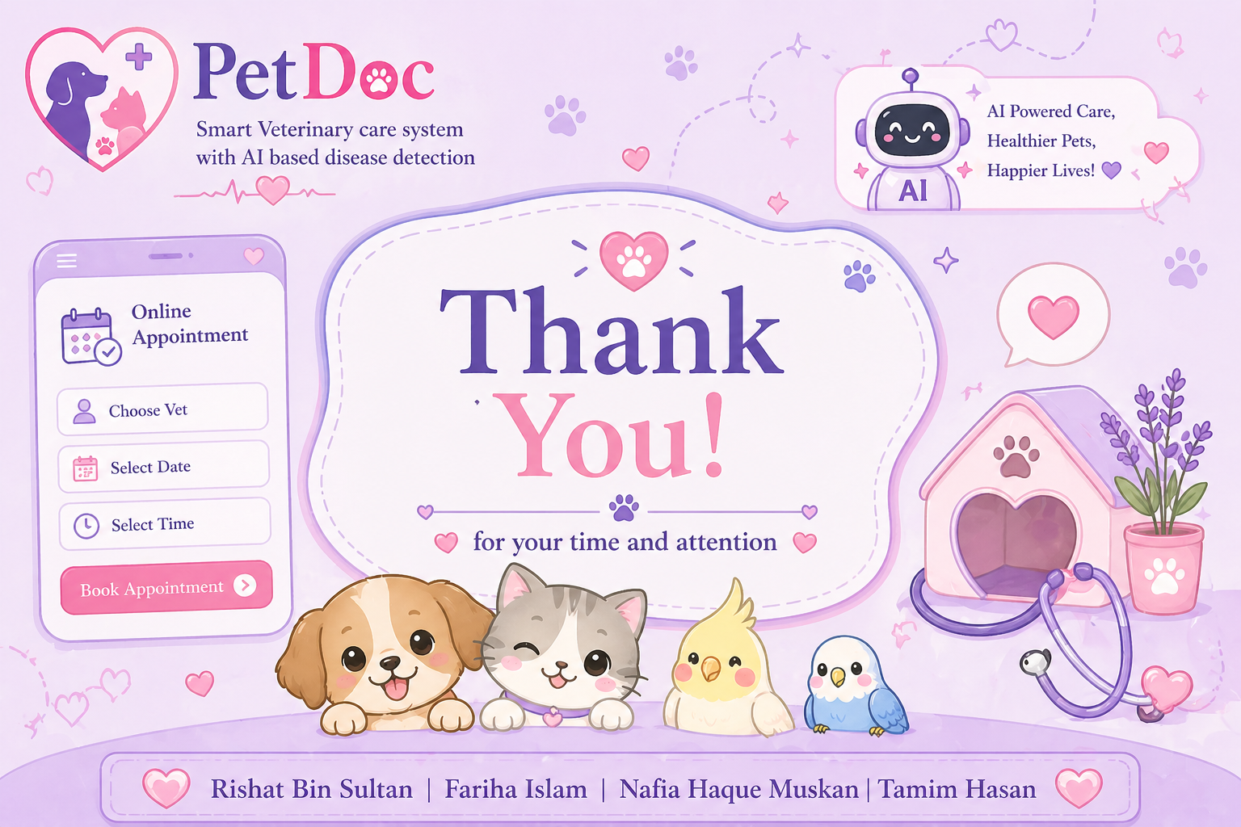

Slide 32
